Slide 1
Medical physics (code)-year 1
L21- Sound in Medicine
By Assistants profess
Dr.Ghania Salim Al-Thaher
Physiology Department
College of Medicine
University of Basrah

Slide 2
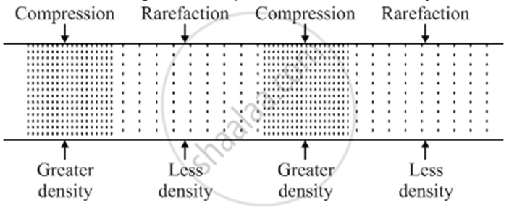
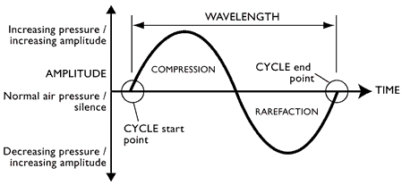
Density, pressure and disturbance:-
The compressions and rarefactions can also be described by density changes and by displacement of atoms and molecules from their equilibriums positions
When compression takes place in the medium, the density and pressure of the medium increase.
When rarefaction takes place in the medium, density and pressure of the medium decrease.

Slide 3
This increase and decrease in density and pressure are temporary. Thus,
Compression is called the region of high density and pressure.
Rarefaction is called the region of low density and pressure.
Energy is carried by the wave as potential and kinetic energy.
The intensity I of sound wave energy passing through 1 m²/s . Or watts per square meter for plane wave I is given by :
I = ½ ρ V A²(2πf)² = ½ Z (AW)²
where ρ : is the density of the medium
V: is the velocity of sound ,f : is the frequency

Slide 4
W: is the angular frequency which equals 2π f
A: is the maximum displacement amplitude of atoms from equilibrium position
Z : equals ρ V, is the acoustic impedance.
is the relationship between acoustic pressure and the speed of particle vibration.
Equal to density of a medium multiplied by propagation speed. Impedance units are rayl . (pascal second per meter)
Z= ρ V
Note: Density increases, impedance increases
Propagation speed increases, impedance increases
The intensity can also be expressed as
𝑰 =(Pₒ)²/ 2Z
Where, Pₒ is the maximum change in pressure.

Slide 5
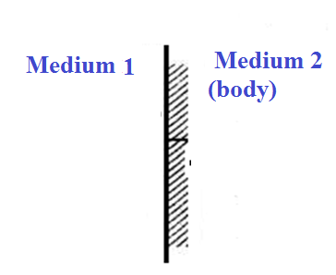
Interaction of sound wave with tissue
A_{o} :is the incident pressure amplitude
R : is the reflected pressure amplitude
T : is the transmitted pressure amplitude
The ratio of R/Aₒ & 𝑻/𝑨ₒ depends on acoustic impedance of the two media, Z₁ and Z₂

Slide 6
Perpendicular incidence.
The impedances of the two media at the boundary determine the strengths of the reflected and transmitted pulses.
The ratio of R/Aₒ depends on acoustic impedance of the two media, Z₁ and Z₂
The relationship is
$$\frac{R}{A_{°}}=\frac{Z_{2}−Z_{1}}{Z_{2}+Z_{1}}$$
For a sound wave in air hitting the body,
Z₁ is the acoustic impedance of air
Z₂ is the a acoustic impedance of tissue.

Slide 7
Intensity reflection coefficient:
IRC =$( {\frac{Z_{2}−Z_{1}}{Z_{2}+Z_{1}})}^{2}$
Note: Difference between impedances increases, IRC decreases.
If Z₁ = Z₂ There is no reflected wave and transmission to the sound medium is complete
If Z₂ ˂ Z₁ The sign change indicates a phase change of reflected wave.

Slide 8
The ratio of the transmitted pressure amplitude T to the incident wave amplitude Aₒ is
𝑻/𝑨ₒ =𝟐𝒁₂/(𝒁₁+𝒁₂)
It is obvious that whenever acoustic impedances differ greatly there is almost complete reflection of sound intensity
This is the reason heart sounds are poorly transmitted into the air adjacent to the chest.
Intensity transmission coefficient:
ITC =1- IRC )= (Z₁/Z₂)(T/Aₒ)²

Slide 9
Perpendicular incidence
When a wave hits at an angle θ₁ (not Perpendicular incidence) to a boundary between two media
sin Ө₁ / V₁ = sin Ө₂ / V₂
V₁ and V₂ are the velocities of sound in two media, Ө₁ is the angle of the incident wave, Ө₂ is the angle of the refracted sound wave. Because sound can be refracted, acoustic lenses can be constructed to focus sound waves.
When the acoustic impedances of the two media are similar almost all of the sound is transmitted into the sound medium,
choosing materials with similar acoustic impedance is called impedance matching.
Getting sound energy into the body requires impedance matching.

Slide 10
Example:
Calculate the ratios of the pressure amplitudes and intensities of the reflected and transmitted sound waves from air to muscle.
$$\frac{R}{A_{∘}}=\frac{1.64×{10}^{6}−430 }{1.64×{10}^{6}+430 }=0.9995$$
$\frac{T}{A_{∘}}=\frac{2(1.64×{10}^{6} ) }{1.64×{10}^{6}+430 }=$1.9995
Also we obtain the ratios of the reflected and transmitted intensities (𝑰 =(Pₒ)²/ 2Z)
(R²/ 2Z₁)/(Aₒ²/2Z₁) = (R/Aₒ)² = (0.9995)² =0.9990
(T²/2Z₂) / (Aₒ²/2 Z₁)=(Z₁/Z₂)(T/Aₒ)² = 0.001

Slide 11
Example.3
Calculate the amplitudes and intensities of the reflected and transmitted sound waves from water(Z₁= 𝟏.𝟒𝟖 𝒙𝟏𝟎 ⁶) to muscle( 𝒁₂= 𝟏.𝟔𝟒)𝒙𝟏𝟎⁶ )using the values from Table(في الكتاب المنهجي)
𝑹/𝑨ₒ=(𝟏.𝟔𝟒−𝟏.𝟒𝟖)𝒙𝟏𝟎⁶/(𝟏.𝟔𝟒+𝟏.𝟒𝟖)𝒙𝟏𝟎⁶
= 𝟎. 𝟎𝟓𝟏𝟑
𝑻/𝑨ₒ=(𝟏.𝟔𝟒)𝒙𝟏𝟎⁶/(𝟏.𝟔𝟒+𝟏.𝟒𝟖)𝒙𝟏𝟎⁶ = 𝟏. 𝟎𝟓𝟏𝟑
(𝑹/𝑨ₒ)²= (𝟎. 𝟎𝟓𝟏𝟑)² = 𝟎. 𝟎𝟎𝟐𝟔
𝒁₁/𝒁₂(𝑻/𝑨ₒ) ² =(𝟏.𝟒𝟖 𝒙𝟏𝟎 ⁶/𝟏.𝟔𝟒 𝒙𝟏𝟎 ⁶ )(𝟏. 𝟎𝟓𝟏𝟑) ² =𝟎. 𝟗𝟗𝟕𝟒

Slide 12
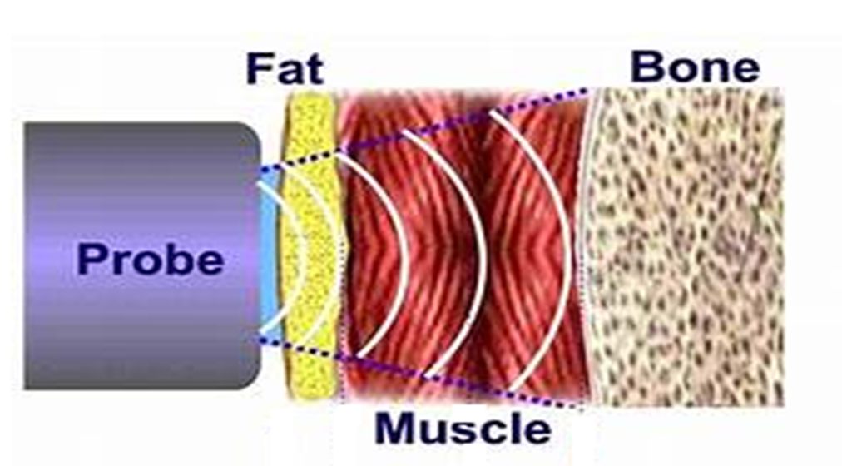
Attenuation of sound wave
Weakening of sound as it propagates. When sound wave passes through tissue, there is some loss of energy due to frictional effects.
Attenuation includes absorption (conversion to heat), and reflection and scattering of the sound as it encounters tissue interfaces.
Absorption is the main factor that contributes to attenuation. Attenuation is quantified in decibels (dB).

Slide 13
The absorption of energy in the tissue causes a reduction in the amplitude of sound wave. The amplitude A at a depth X cm in medium is related to initial amplitude Aₒ(x=0) by the exponential equation
𝑨 = 𝑨ₒ 𝒆^{−𝜶𝒙}
Where α is the absorption coefficient for the medium. (Attenuation coefficient)
Attenuation coefficient (alpha) is the attenuation that occurs with each cm the sound wave travels. The farther the sound travels the greater the attenuation.

Slide 14
Note: If attenuation coefficient increases, attenuation increases. If path length increases, attenuation increases
Attenuation increase with increasing frequency:
Attenuation (dB) = $α$× frequency (MHz) x path length (cm)
Attenuation limits the depth of images (penetration).
Note: If frequency increases penetration decreases
Frequencies used in diagnostic ultrasound range from 2 to 15 MHz. Lower frequencies are used for deeper penetration.

Slide 15
Since the intensity is proportional to the square of the amplitude, its dependence with depth is
I = I₀ 𝒆^{−2𝜶𝒙}
Where 𝑰₀ is the incident intensity at X = 0 and I is intensity at a depth X,
2α absorption coefficient. The half-value thickness (HVT) is the tissue thickness needed to decrease 𝑰ₒ to 𝑰ₒ/2.

Slide 16
The amplitude A at a depth X cm in medium is related to initial amplitude Aₒ(x=0) by the exponential equation
𝑨 = 𝑨ₒ 𝒆^{−𝜶𝒙}
Where α is the absorption coefficient for the medium
I $∝$ A²
then
I = I₀ 𝒆^{−2𝜶𝒙}
Where 𝑰₀ is the incident intensity at X = 0 and
I is intensity at a depth X,
α : absorption coefficient.

Slide 17
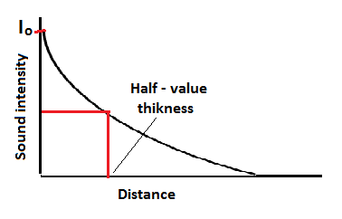
The half-value thickness (HVT) is the tissue thickness needed to decrease 𝑰ₒ to 𝑰ₒ/2.
I ½ 𝑰ₒ = 𝑰ₒ 𝒆^{−2𝜶HVT}
HVT =ln (2)/ 2α

Slide 18
Example.4
What is the attenuation of sound intensity by 1 cm of bone at 0.8, 1.2 and 1.6 MHz?
At 0.8 MHz, the HVT is 0.34 cm, there for 1 cm is about 3 HVT and intensity is reduced by 2³ , or by factor 8. (1/2)^3
At 1.2 MHZ, the HVT is 0.21: 1 cm is nearly 5 HVT, and intensity is reduced by almost 2⁵, or by factor 32 . (1/2)^5
At 1.6 MHz, the HVT is 0.11 cm : 1 cm is about 9HVT, and intensity is reduced by 2⁹, or by factor of 512 . (1/2)^9

Slide 19
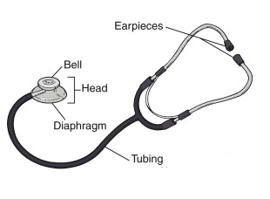
The Stethoscope
The act of listening sounds with a stethoscope is called mediate auscultation or usually just auscultation.
The main parts of a modern stethoscope are:
Bell, which is either open or closed by a thin diaphragm,
The tubing and
The earpieces.

Slide 20
The open bell is an impedance matcher between the skin and the air and accumulates sounds from the contacted area.
The skin under the open bell behaves like a diaphragm.
The skin diaphragm has a natural resonant frequency at which it most effectively transmits sound;

Slide 21
It is possible to enhance the sound range of interest by
changing the bell size
and varying the pressure of the bell against the skin and the skin tension.
A low frequency heart murmur will appear to go away if the stethoscope is pressed hard against the skin.
Open bell used to hear low frequency sound

Slide 22
A closed bell is merely a bell with a diaphragm of known resonant frequency, usually high, that tunes out-low frequency sound,
it is resonant frequency is controlled by the same factors that control the frequency of the open bell pressed against the skin.
The closed bell stethoscope is primarily used for listening to lung sounds, which are of higher frequency ranges of heart and lung sounds.
Closed bell used to hear high frequency sound

Slide 23
What is the best shape for the stethoscope?
1-It is desirable to have a bell with as small a volume as possible.
The smaller the volume gas, the greater the pressure changes for given movement of the diaphragm at the end of the bell. (P$∝ \frac{1}{V}$ )
2-The volume of tubes should also be small. And there should be little frictional loss of sound to the walls of the tube.

Slide 24
Below about 100 Hz tube length does not greatly affect the efficiency.
But above this frequency, decreases as the tube is lengthened.
At 200 Hz 15 dB is lost in changing from tube 7.5 cm long to tube 66 cm long.
A compromise is a tube with a length of about 25 cm and diameter of 0.3 cm.

